Slide 1
ELISA Topic Modelling
Gaurav Bose
Eswar Lakshminarayan
Dr.Greg Ver Steeg
Information Sciences Institute

Slide 2
The Method
A general problem for low resource languages is that we don’t have enough coverage in the scenario to learn good translations. We have explored ideas to improve coverage like the Chinese Room, but for this to be most effective, we have to identify a seed set of scenario relevant documents in the first place.
Using a combination of unsupervised and semi-supervised methods directly on documents in the incident language, we should be able to find scenario relevant topics and then focus our efforts on these types of documents.

Slide 3
The Goal
Languages like Oromo, Tamil and Tigrinya do not boast a rich dictionary. Therefore any kind of Language Processing for the same becomes difficult.
We address this issue by using COREX and Guided LDA methods of finding out relevant documents using a combination of methods.
But first, we need to talk more about the data that we have.

Slide 4
Data Preprocessing
Remove Hyperlinks
Remove Keywords (‘RT-Retweet’)
Remove Emoji’s and Punctuations
Remove Dates
Remove documents with less than 5 words

Slide 5
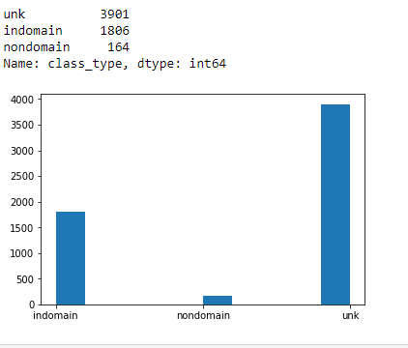
Document Type

Slide 6
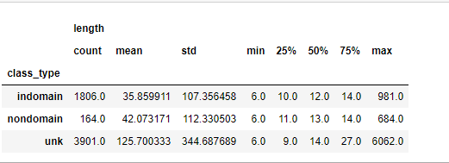
Document Length

Slide 7
Semi-supervision to identify scenario-relevant documents in IL
English scenario description
Fire…
Apply expensive learning to relevant documents:
Chinese room
Native informant
...
IL keywords: hongee, galaana
IL documents
----
----
----
----
----
----
----
----
----
----
----
----
----
----
----
Semi-supervised topic learning in IL, using “Anchored CorEx”
----
----
----
----
----
----
----
----
----
----
----
----
----
----
----
Notes:
A general problem for low resource languages is that we don’t have enough coverage in the scenario to learn good translations. We have explored ideas to improve coverage like the Chinese Room, but for this to be most effective, we have to identify a seed set of scenario relevant documents in the first place. Using a combination of unsupervised and semi-supervised methods directly on documents in the incident language, we should be able to find scenario relevant topics and then focus our efforts on these types of documents.
A preliminary result is shown on the next slide

Slide 8
Anchored Corex
The principle of Cor-relation Ex-planation has recently been introduced as a way to build rich representations that are informative about relationships in data.
CorEx or "Correlation Explanation" discovers a hierarchy of informative latent factors.
Using a few keywords we can generate relevant documents from a pool of loosely translated documents with a not so rich dictionary.

Slide 9
Guided LDA
Much like COREX Guided LDA benefits by Incorporating Lexical Priors to the unsupervised Learning methods of Latent Dirichlet Algorithm.
LDA is basically a generative statistical model that allows sets of the observations to be explained by unobserved groups that explain why some parts of the data are similar.

Slide 10
Results
Keywords #1
More Keywords #2
Method | Precision | Recall | F1 Score |  | Precision | Recall | F1 Score
Corex- Anchorred | 0.889 | 0.089 | 0.162 |  | 0.901 | 0.137 | 0.238
Guided LDA | 0.885 | 0.103 | 0.184 |  | 0.823 | 0.059 | 0.110

Slide 11
Keywords #1 and #2
Topic 1: hoongee, hongee
Topic 2: galaana, galaanaa
Topic 3: balaa
Topic 1: hoongee, hongee, oolaa
Topic 2: galaana, galaanaa, guutuu, lolaa
Topic 3: balaa, dhibee, irraa
Topic 4: sochii, lafaa

Slide 12
Differences
COREX uses a Binary true or false sparse Document Term Matrix in its algorithm which tells if a keyword is present or missing in a document.
Guided LDA uses a seeding technique and generates a count sparse matrix which gives a normalized count of the presence of a word in a document.

Slide 13
Ranking
Identifying relevant documents is a major factor in both these methods.
Finding relevant documents and ranking them based on the features is the 2nd step to this method.
Here we discuss different ranking methods by considering equal number of Indomain and Non – Domain documents.

Slide 14
Results
Method | Precision @ 20 | Precision @ 50
Keyword Count | 0.368 | 0.388
TF-IDF Sum | 0.470 | 0.384
Weighted Sum | 0.385 | 0.388
Weighted Product | 0.384 | 0.333

Slide 15
Inferences
For the Ranking Methods:
Will update based on our discussion

Slide 16
Conclusion
Should we show other results and benefits of the method here?

